Slide 1
Seasonal priority effects (appear to) contribute to the competitive dominance of invasive Hesperis matronalis
Dan Buonaiuto
March 2021

Slide 2
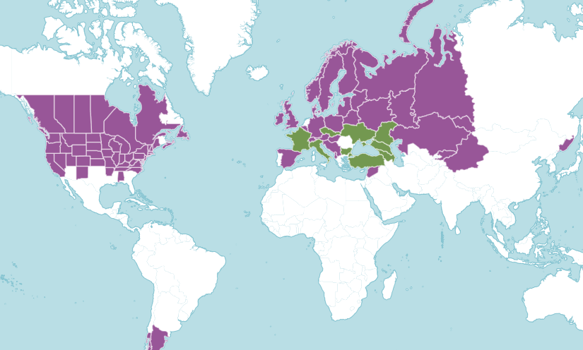
Hesperis matronalis (Brassicaceae) “Dames Rocket”, “Garden Phlox”

Slide 3
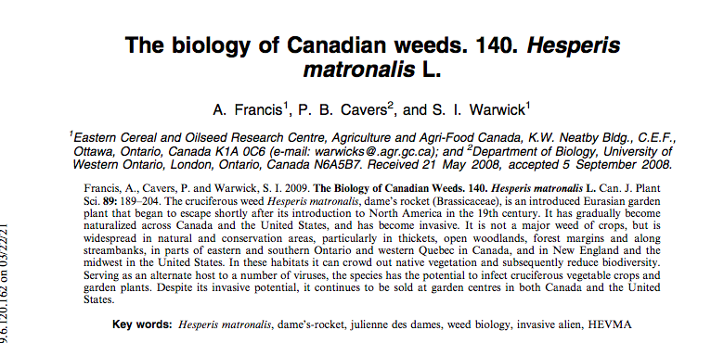
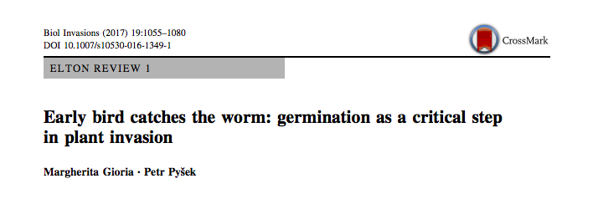
Strong competitor (invader)
Rapid and successful germination with no dormancy requirement
Coincidence? Mechanism? Or a little of both.

Slide 4
Seasonal priority effects
Planting interval studies show good evidence for “short term priority effects” on inter-specific competition.
Intervals usually 2 weeks minimum, always with grassland species. Unclear how biologically relevant these are for other systems.
Eg. For seeds with dormancy or spring germinators in general, rate of release for dormancy (climate sensitivity) mediates SPEs.

Slide 5
Q1: For temperate herbs, are inter-specific climate sensitives different enough to generate SPEs?
Q2: Does this matter to competition?

Slide 6
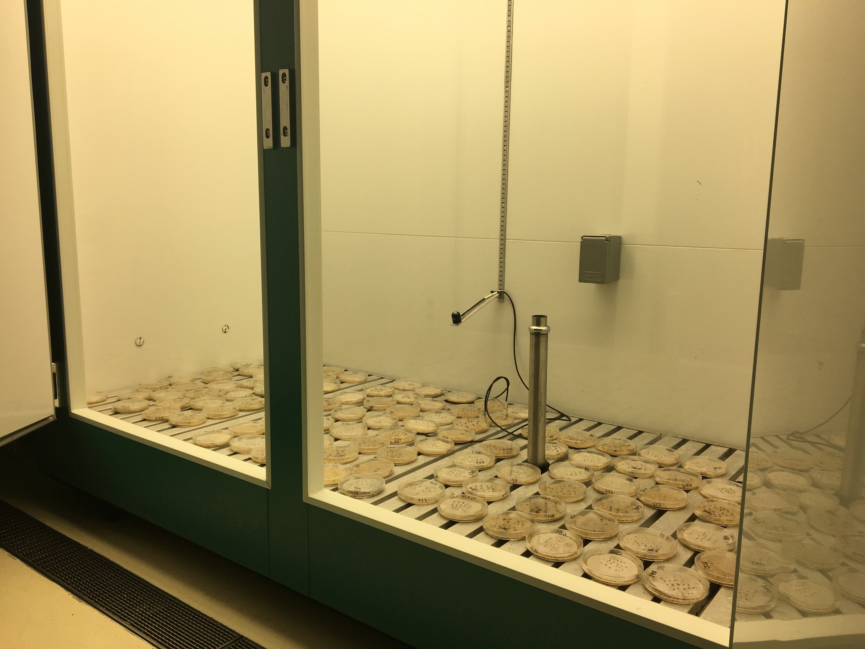
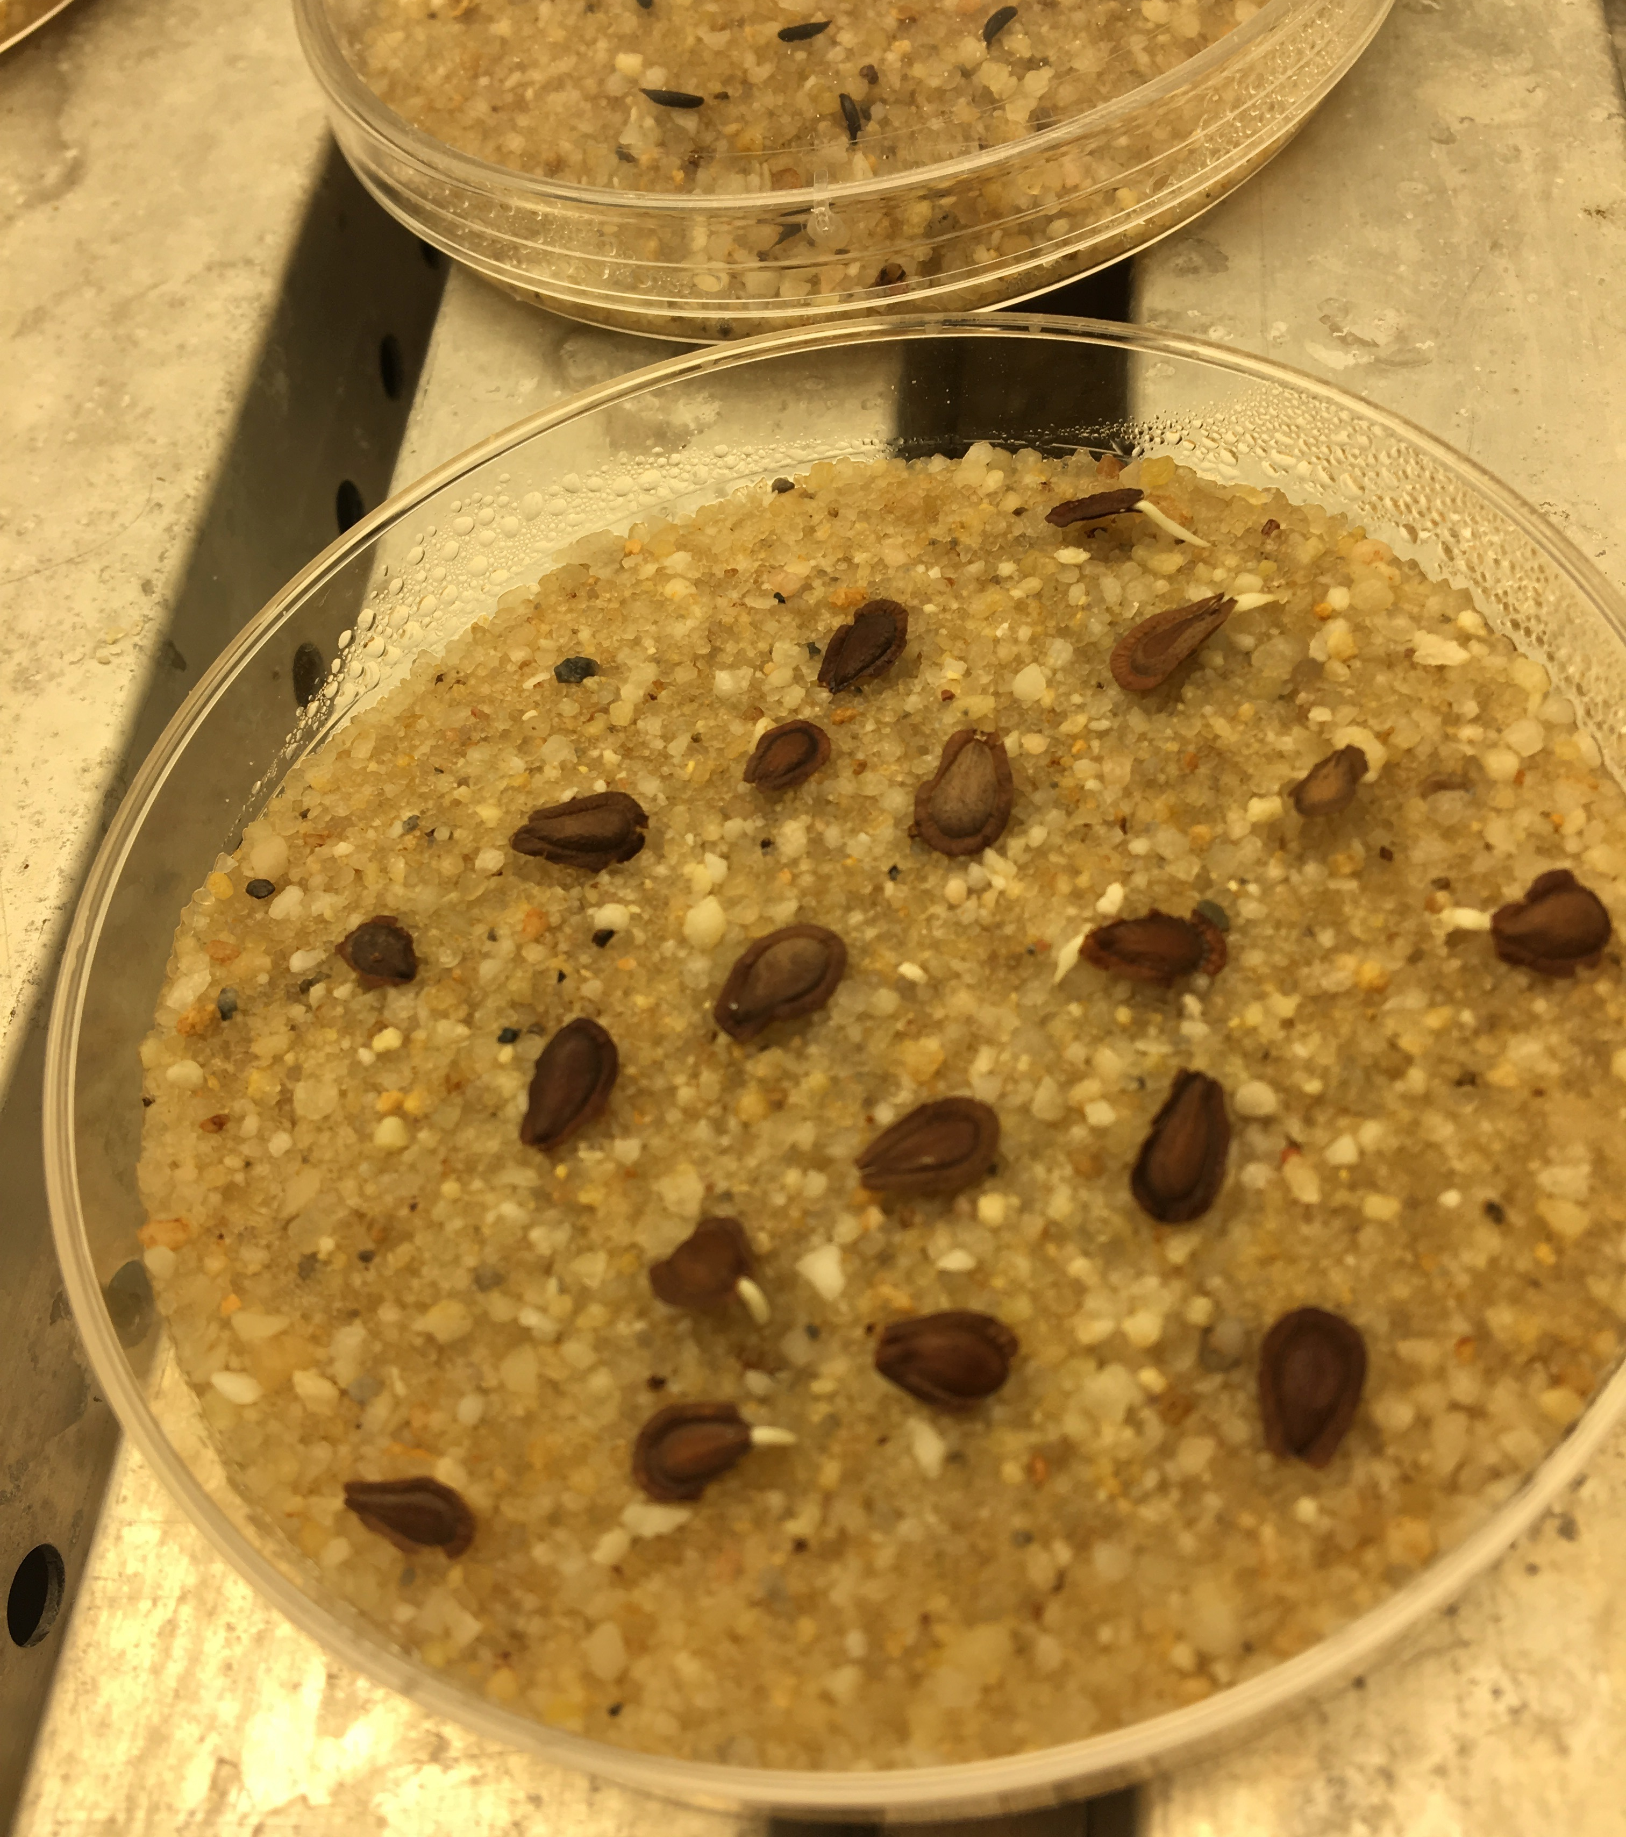
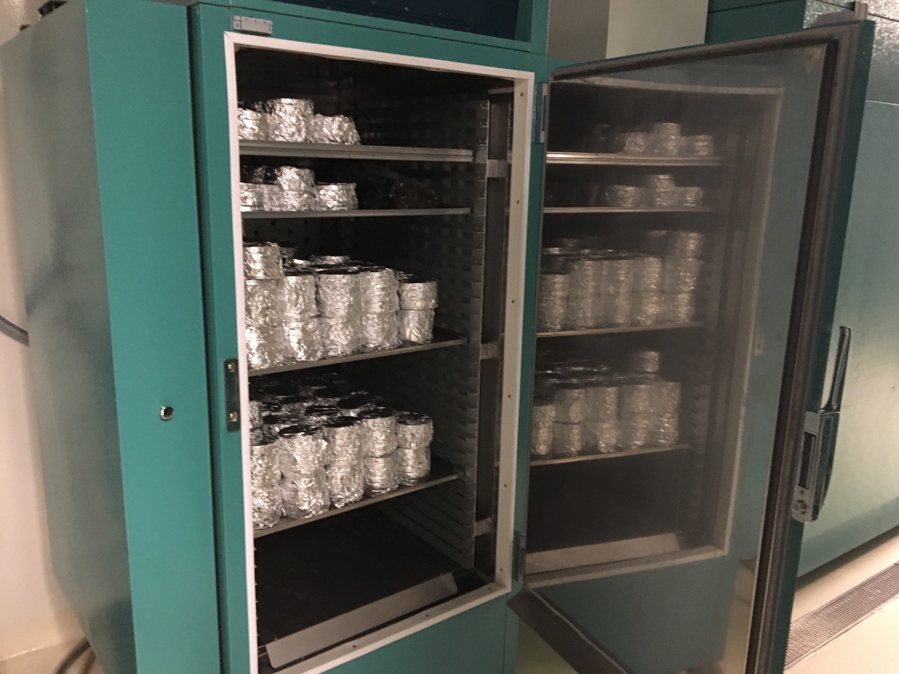

Slide 7
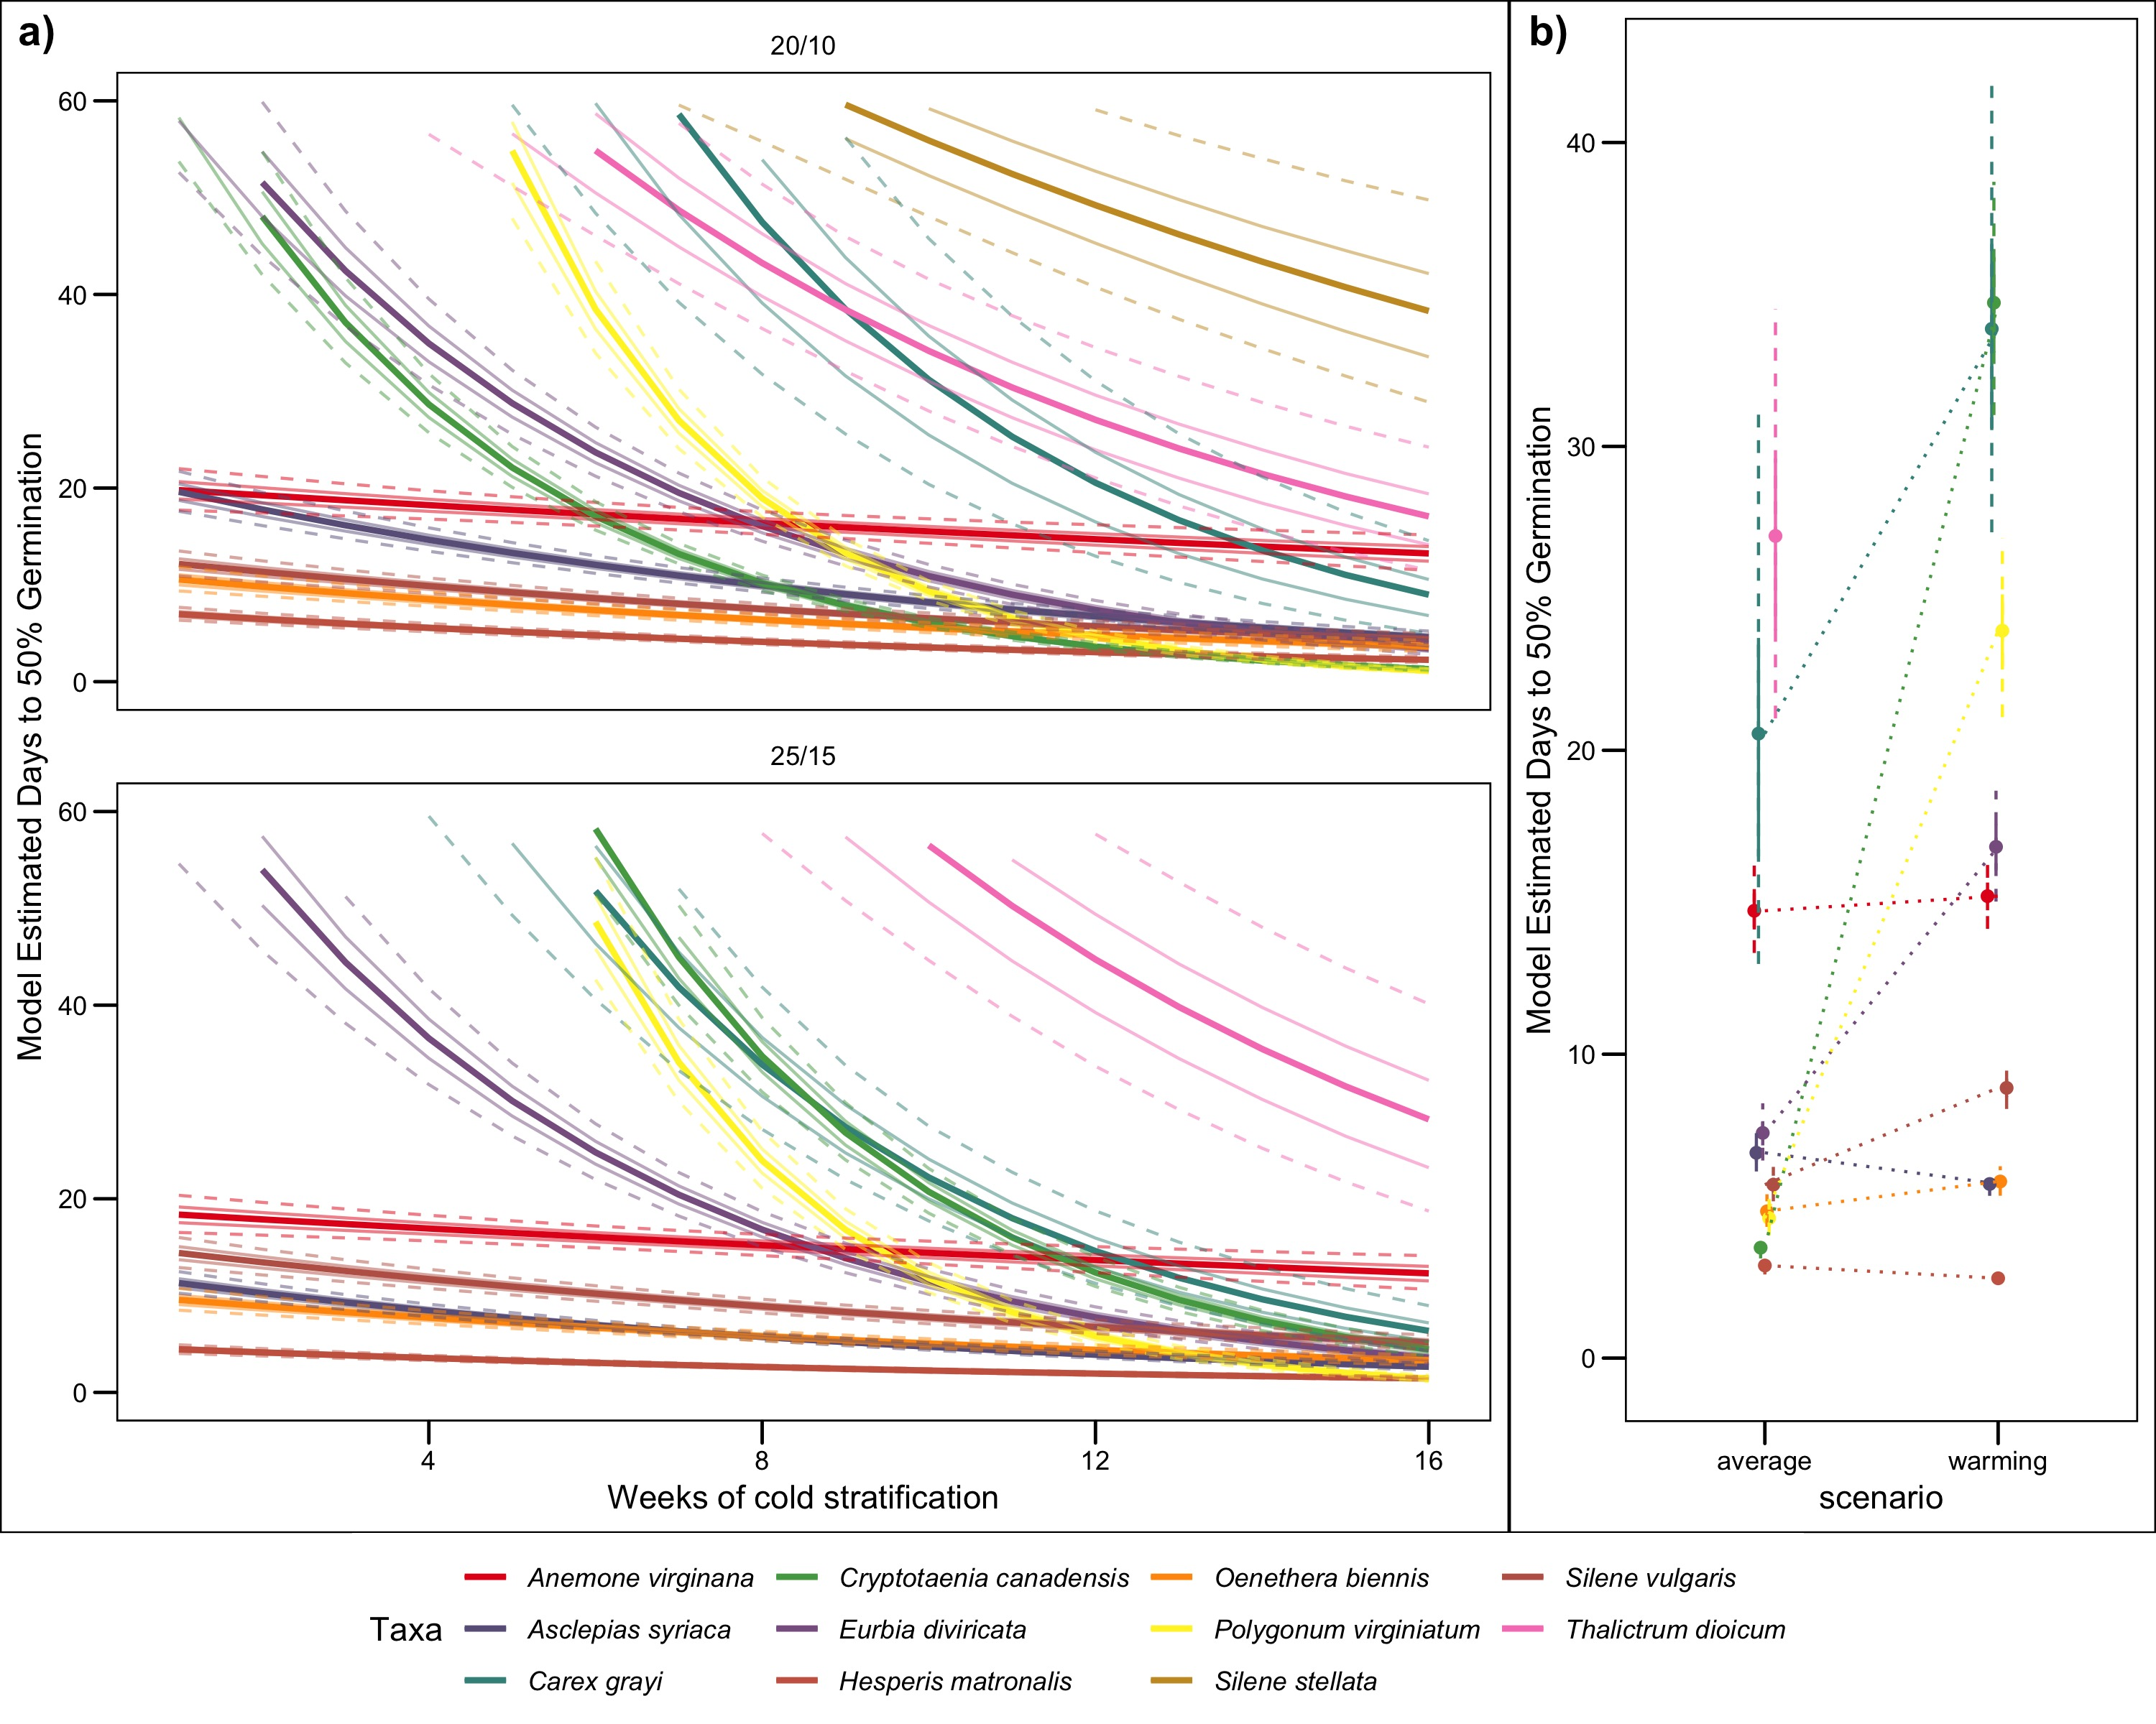

Slide 8
Cryptotaenia canadensis “Honewort”
“In conditions ideal for Honewort, it can be aggressive. In one case, it reportedly out-competed garlic mustard and became a nuisance in its own right.”

Slide 9
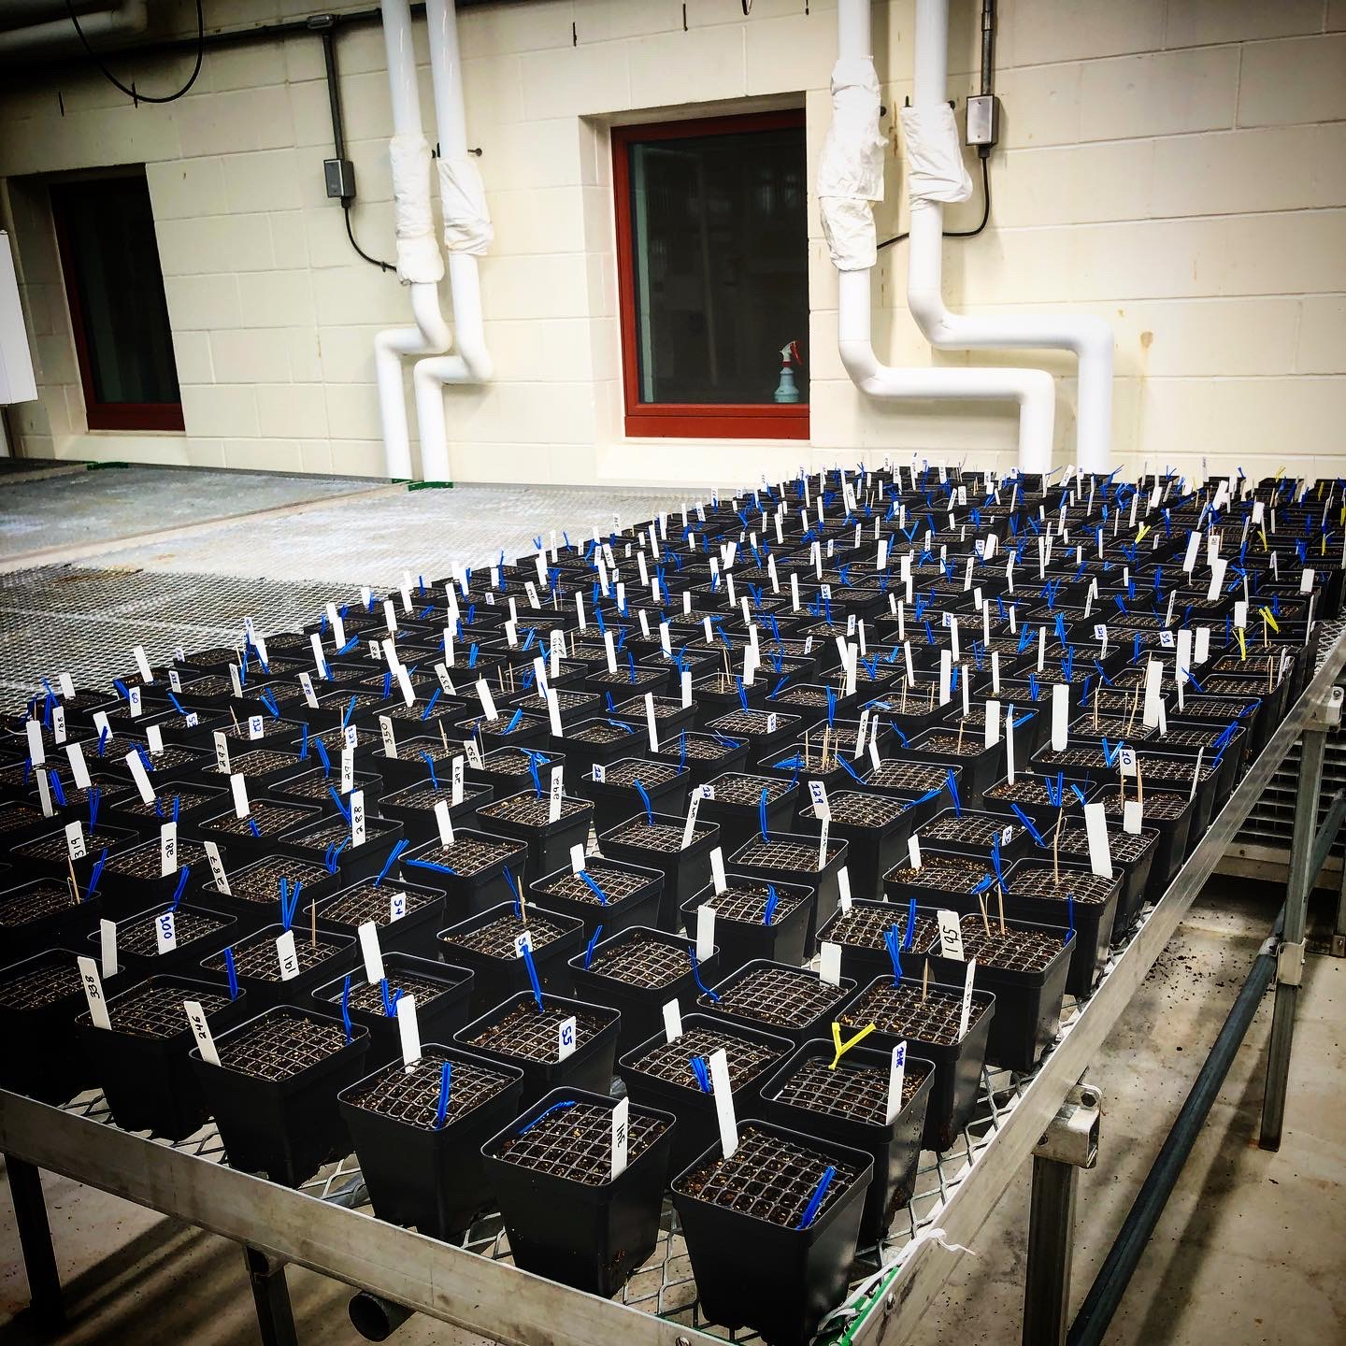
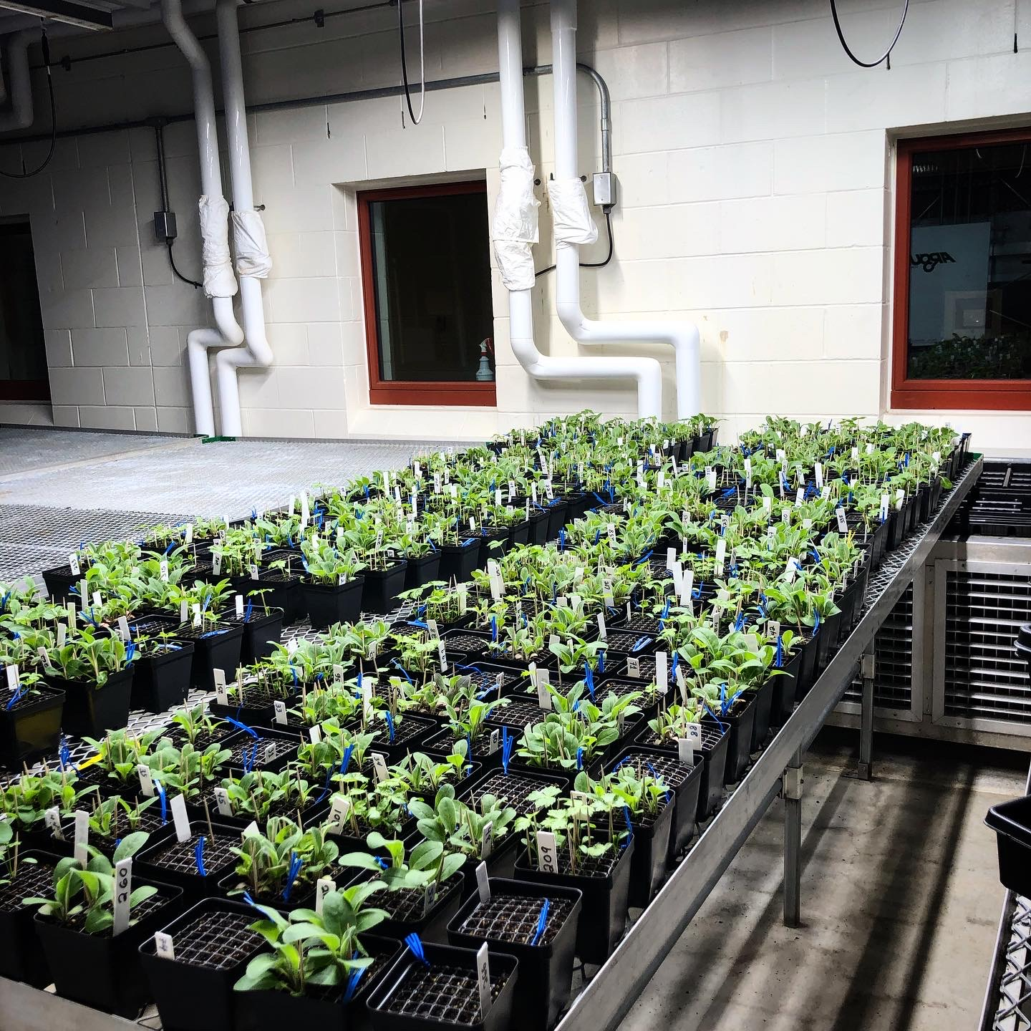
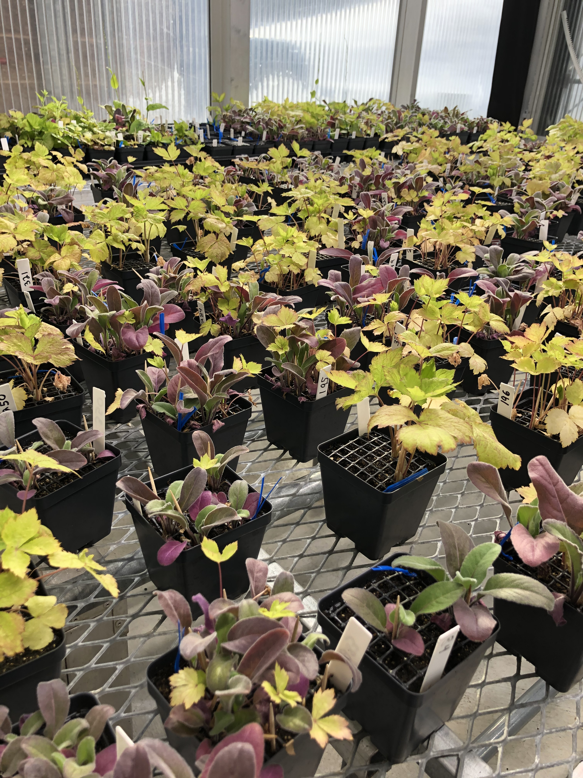
Experiment
Vary hetero- & con-specific density and apply stratification treatment.

Slide 10
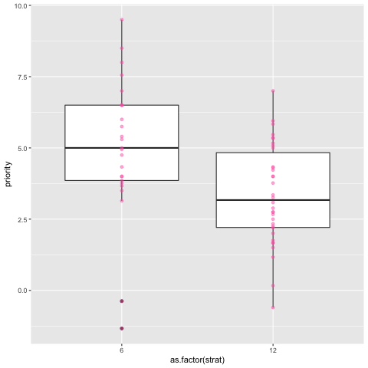

Slide 11
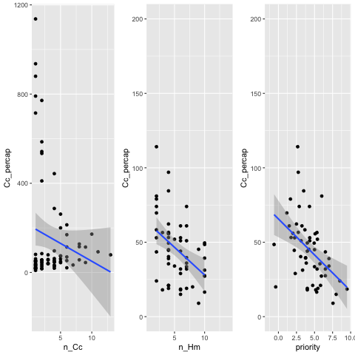
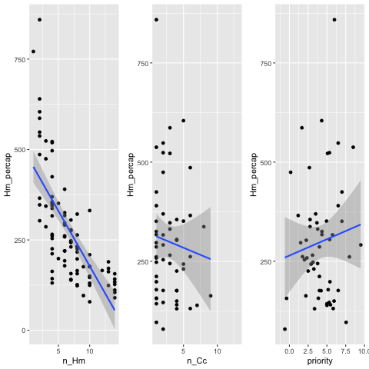

Slide 12
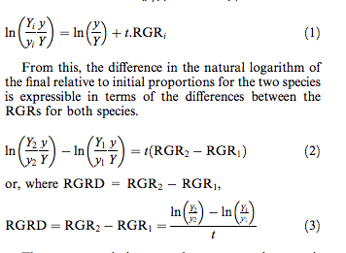
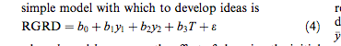
Connolly and Wayne 2005

Slide 13
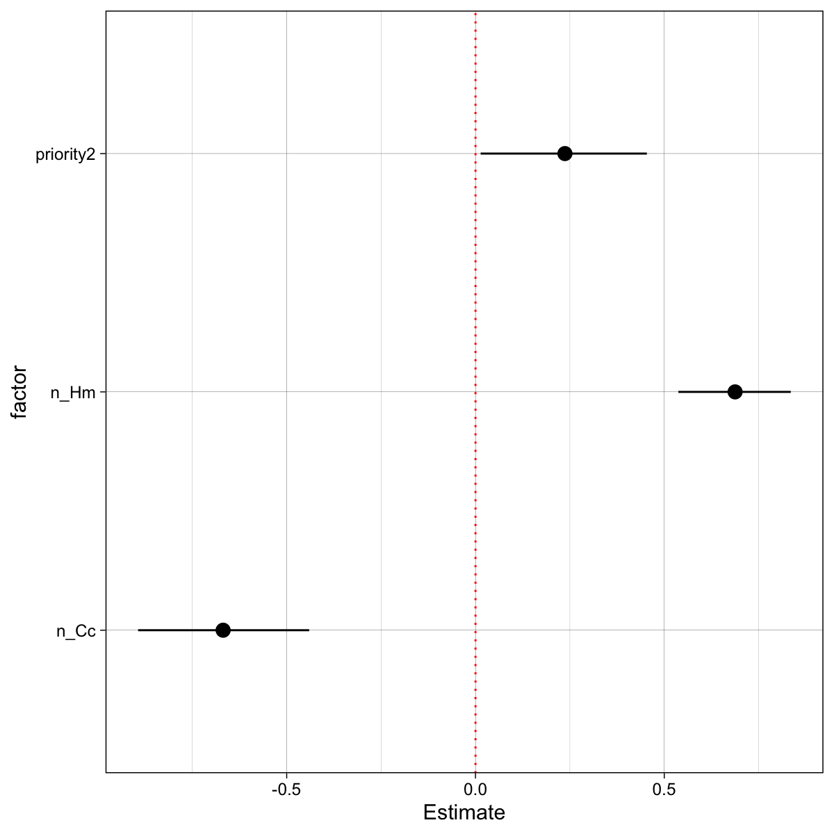
A positive value of bi (for i =1 or 2) means that increasing species i in the initial community will enhance the difference in average RGRs in favour of species 2 and hence will tilt the final composition more towards that species. A negative value has the opposite effect. The two coefficients b1 and b2 show how changes in initial abundance of the species can influence the growth differential between species and we call them influence coefficients. The influence of a species is the difference between its intraspecific effect on its own RGR and its interspecific effect on the RGR of the other species. A positive value of b3 means that for a particular mixture the environmental factor increases the RGRD and hence increases the proportion of species 2 in the composition. If all three coefficients (b1, b2 and b3) are zero then the difference in average RGR is not affected by initial composition or applied treatment and will be constant (b0).
Notes:
Hm is sp2
Cc is sp1

Slide 14
Next steps
Factor in seed size and non-germers into RGRD equations
Decide if there are better competition equations to use (doesn’t really handle zeros well (assumes mixtures)
Try (or model) other metrics for germination rate (T50).
Quantify importance of priority effect vs. density effects (interpreting coefficients)

